Slide 1


Slide 2
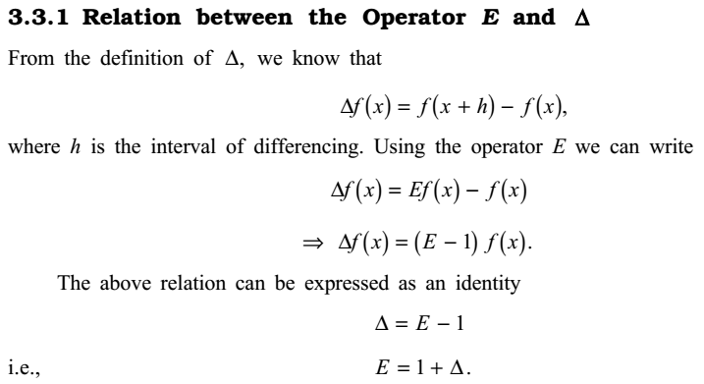

Numerical Methods
National University of Science and Technology, Islamabad

Slide 3
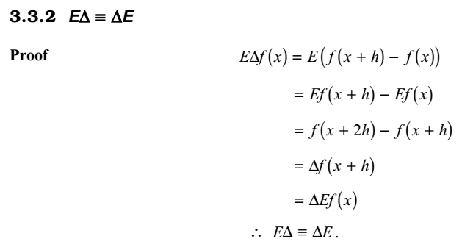
Numerical Methods
National University of Science and Technology, Islamabad

Slide 4

Numerical Methods
National University of Science and Technology, Islamabad

Slide 5

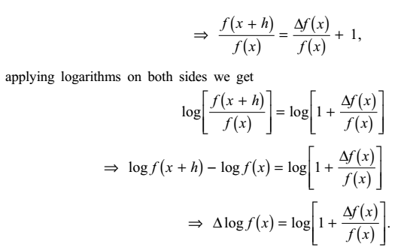
Numerical Methods
National University of Science and Technology, Islamabad

Slide 6

Numerical Methods
National University of Science and Technology, Islamabad

Slide 7
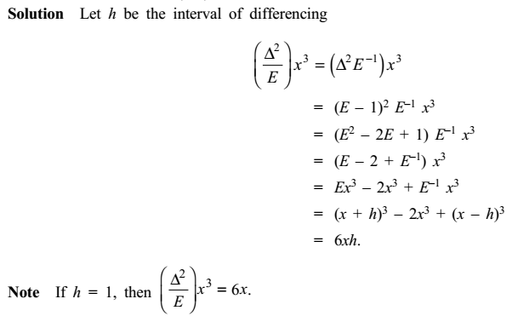
Numerical Methods
National University of Science and Technology, Islamabad

Slide 8
Numerical Methods
National University of Science and Technology, Islamabad

Slide 9
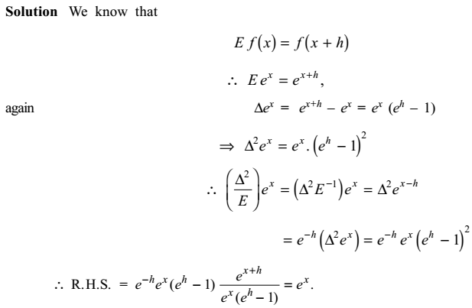
Numerical Methods
National University of Science and Technology, Islamabad

Slide 10
Numerical Methods
National University of Science and Technology, Islamabad

Slide 11
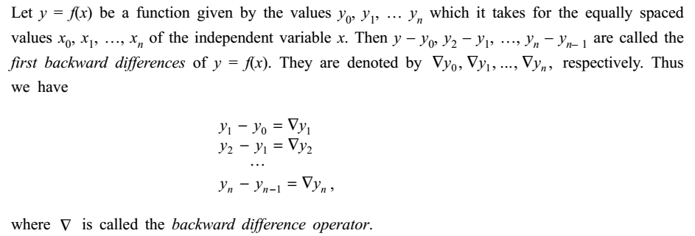
Numerical Methods
National University of Science and Technology, Islamabad

Slide 12
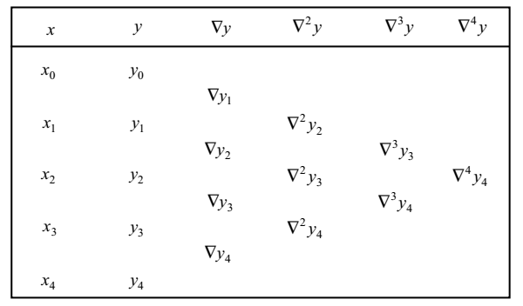
Numerical Methods
National University of Science and Technology, Islamabad

Slide 13
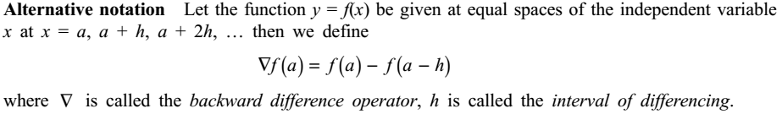
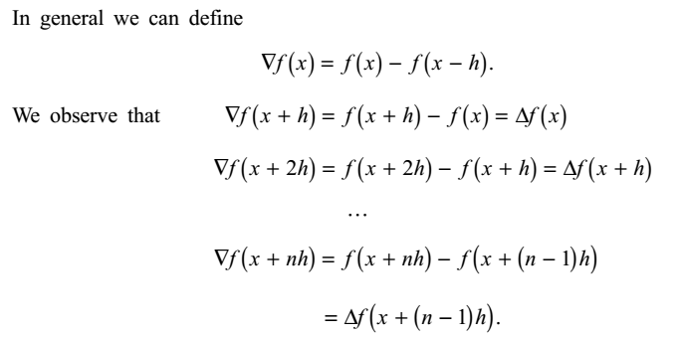
Numerical Methods
National University of Science and Technology, Islamabad

Slide 14
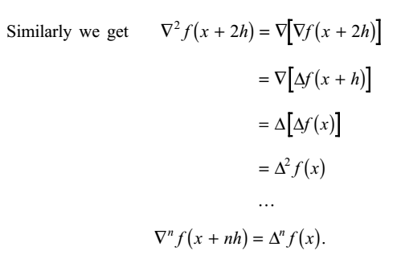
Numerical Methods
National University of Science and Technology, Islamabad

Slide 15
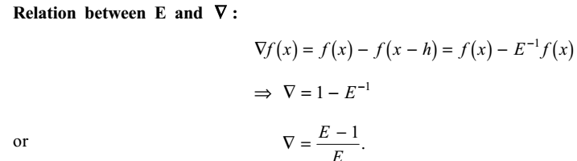
Numerical Methods
National University of Science and Technology, Islamabad

Slide 16
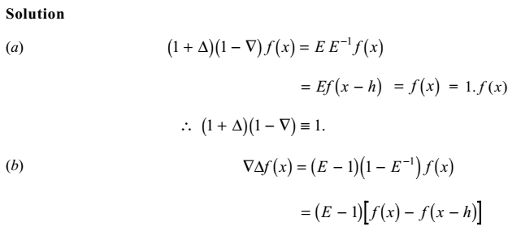
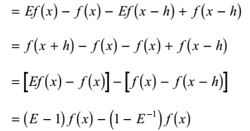
Numerical Methods
National University of Science and Technology, Islamabad

Slide 17
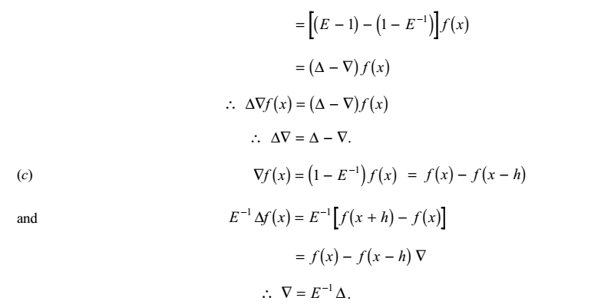
Numerical Methods
National University of Science and Technology, Islamabad

Slide 18
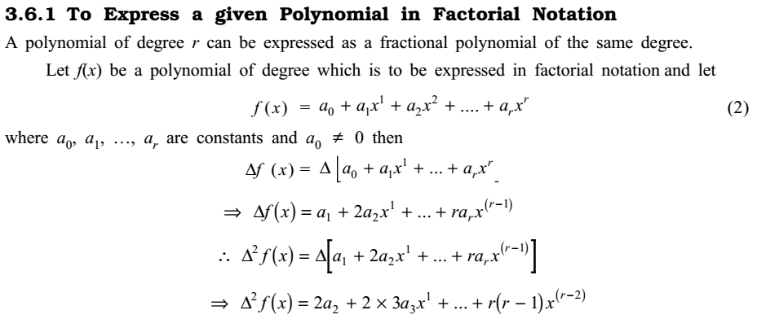
Numerical Methods
National University of Science and Technology, Islamabad

Slide 19
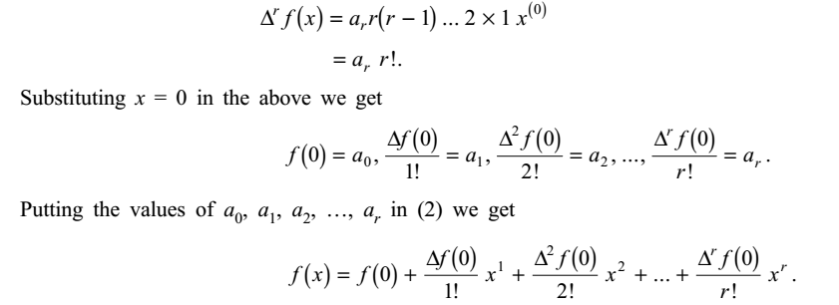
Numerical Methods
National University of Science and Technology, Islamabad

Slide 20
Numerical Methods
National University of Science and Technology, Islamabad

Slide 21
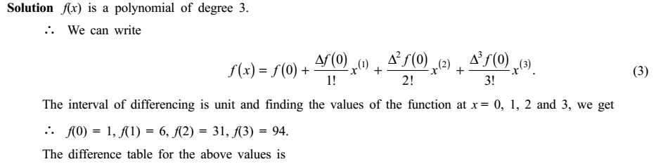
Numerical Methods
National University of Science and Technology, Islamabad

Slide 22
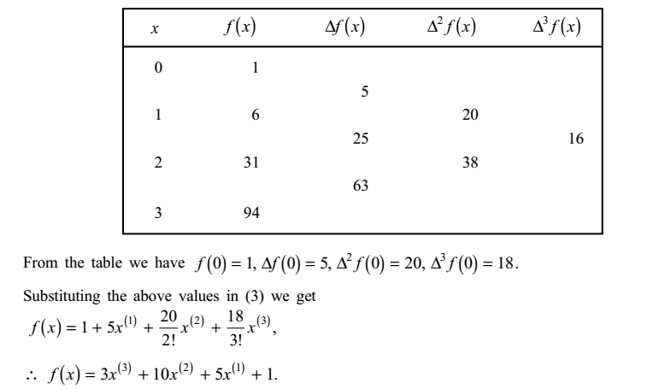
Numerical Methods
National University of Science and Technology, Islamabad

Slide 23
Numerical Methods
National University of Science and Technology, Islamabad

Slide 24
Numerical Methods
National University of Science and Technology, Islamabad

Slide 25
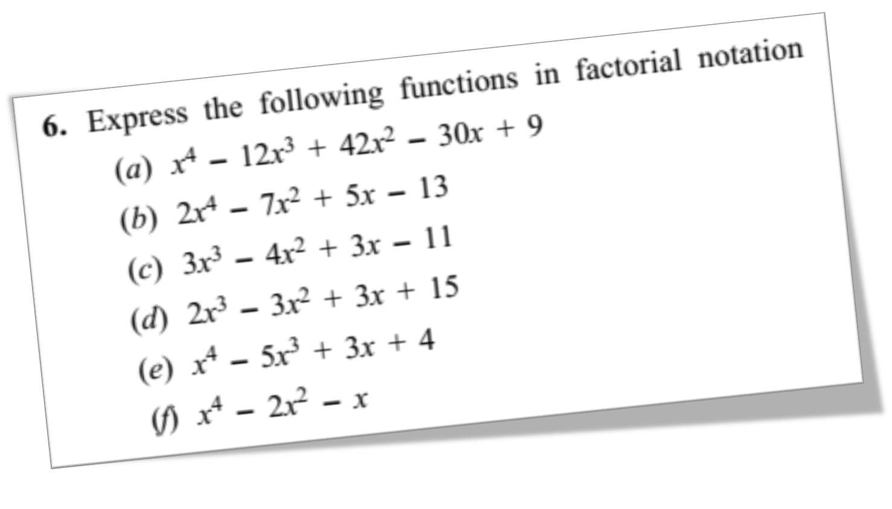
Numerical Methods
National University of Science and Technology, Islamabad

